Slide 1
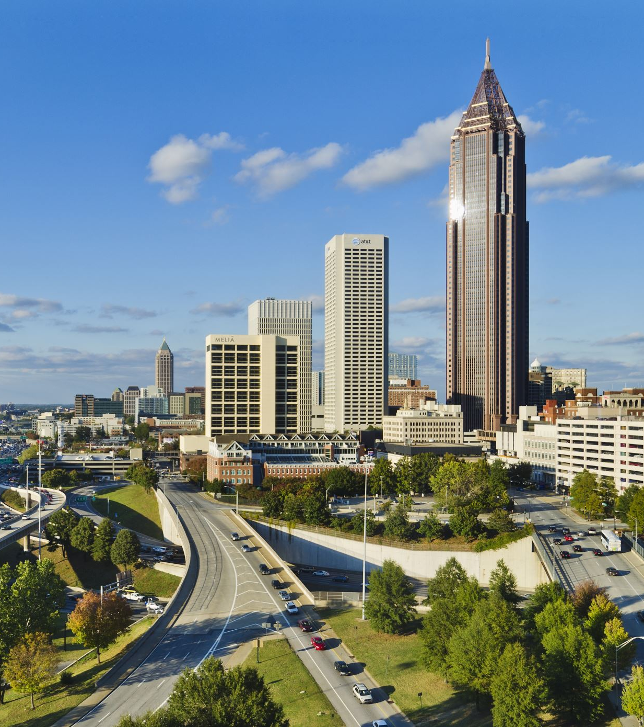

A GIS-Based Accessibility and Equity Analysis of Urban Park Distribution
Primary Presenter: Tahsin Tabassum
Masters in Regional and City Planning
Co-Author: Ladan Mozaffarian, PhD
Assistant professor of Regional and City Planning
University of Oklahoma

Slide 2
Overview
Research Question
Objective of The Study
Literature review
Study Area Profile
Methodology
Result and Discussion
Recommendations and Planning Implication

Slide 3
Research Question
How equitable is the distribution and accessibility of urban parks in Dallas, Texas, in relation to population density and spatial need?

Slide 4
Objective of the Study
To identify service areas for different park categories and evaluate their accessibility within walking distance using network analysis
To investigate equity in park accessibility, highlighting potential disparities in green space access for different population segments through Lorenz curve

Slide 5
Literature Review
Importance of Urban Parks
Types of Urban Parks
Accessibility to Urban Parks
Methods of Accessibility Analysis
Methods of equity analysis

Slide 6
Importance of Urban Parks
Essential for creating sustainable and livable cities.
Provide designated open spaces focused on plants and water for public use.
Vary in size and function, from small pockets to large municipal spaces.
Enhance community well-being by offering recreational and social opportunities.

Slide 7
Types of Urban Parks
Pocket Parks
Small, accessible areas typically less than one acre. Offer greenery, seating, and playgrounds .Often created on vacant lots or integrated into private developments. Became popular as urban land prices increased.
Civic Plaza Parks
Flexible public gathering spaces for civic purposes and commercial activities. Minimum size of one acre. Feature hardscape elements, trees, seating, public art, and water features. Originated from traditional town squares used for civic gatherings and events.
Linear Parks
Connect urban elements, providing a green corridor. Include multi-use trails, seating areas, fitness stations, and recreational components. Size varies depending on the urban context. Serve as a resource for both recreation and environmental protection.

Slide 8
Types of Urban Parks
Neighborhood Parks
Serve residential neighborhoods, typically ranging from 2 to 5 acres. Include playgrounds, playfields, picnic facilities, and sometimes sports courts. Service radius of 1/4 to 1/2 mile, serving 3,000 to 6,000 people. Track funding and land availability for park development
Community Parks
Larger recreational facilities serving a 1- to 2-mile radius. Typically range from 5 to 20 acres. Feature ball diamonds, playfields, tennis courts, shelters, restrooms, and natural areas. Cater to broader community needs beyond neighborhood parks.
Special Purpose Parks
Designed for specific activities (e.g., aquatic centers, ice skating, golf courses).Serve the entire park district and attract visitors from beyond the local area. Size varies based on the facility's requirements. Include historical sites, community centers, theme parks, and water

Slide 9
Criteria for Effective Urban Parks
Size and Capacity
Must be large enough to accommodate the local population
Provide sufficient amenities to meet community needs
Proximity and Reachability
Located within reasonable walking distance for pedestrians.
Designed to be easily accessible from surrounding areas.
Design and Distribution
Consideration of park geometry and connectivity
Strategic placement to avoid clustering and ensure equitable access across the city (La Rosa, 2014; Wright Wendel et al., 2012)

Slide 10
Methods of Spatial Accessibility Analysis
Euclidean Buffer Method
Calculates service areas based on linear distance ("as-the-crow-flies").
Limitations:
Overestimates accessibility
Ignores physical barriers and the park's actual entry points.
Does not consider park shape or urban infrastructure.
Network Analysis Approach
Uses actual travel routes and network connectivity
Advantages:
Reflects real-world scenarios
Provides precise boundaries for park accessibility within given distances.
Accounts for impedances like traffic, crossings, and terrain (Nicholls, 2001).

Slide 11
Methods of Distributional Equity Analysis
Lorenz Curve and Gini Coefficient:
The Lorenz curve plots the cumulative share of transportation benefits (e.g., transit service hours, accessibility) against the cumulative population share.
The Gini coefficient, which ranges from 0 (perfect equality) to 1 (maximum inequality), quantifies the level of disparity.
Cost-Benefit Analysis (CBA):
How the benefits (e.g., reduced travel times, increased access to jobs) and costs (e.g., construction disruption, fares) are distributed across different income or racial groups.

Slide 12
Study Area Profile
Dallas, the third most populous city in Texas and the ninth most populous in the United States
A population of around 1.3 million people up to 2022.

Slide 13
Methodology
This study used four data sources
Geographical distribution of urban parks, which was obtained from Google Earth Pro. Then it was converted to the shapefiles in ArcGIS pro.
The city’s street network(City of Dallas GIS Services, n.d.)
Land use data of Dallas(City of Dallas GIS Services, n.d.)
Census Data of population of 2021 (Census Bureau Data, n.d.)

Slide 14
Methodology
Using Google Earth Pro to find the park
1
Selecting the service area by reviewing the literatures
2
Using network analysis for parks' service regions
3
Identifying accessibility and spatial sufficiency
4
Suggesting recommendation and planning implication
5

Slide 15

Result and Discussion

Slide 16
Type | Number | Standard Service area
Pocket/Mini Parks | 25 | Within a ¼ mile
Civic Plaza Parks | 4 | Entire city
Linear Parks | 11 | Not defined
Neighborhood Park | 62 | ¼ to ½ mile radius
Community Park | 42 | Within a ½ mile to over 3 miles radius.
Special Purpose Park | 44 | Beyond the boundaries of the District.
Metropolitan Park | 1 | The entire city
Dog Park | 6 | Not defined
Parks in Dallas

Slide 17
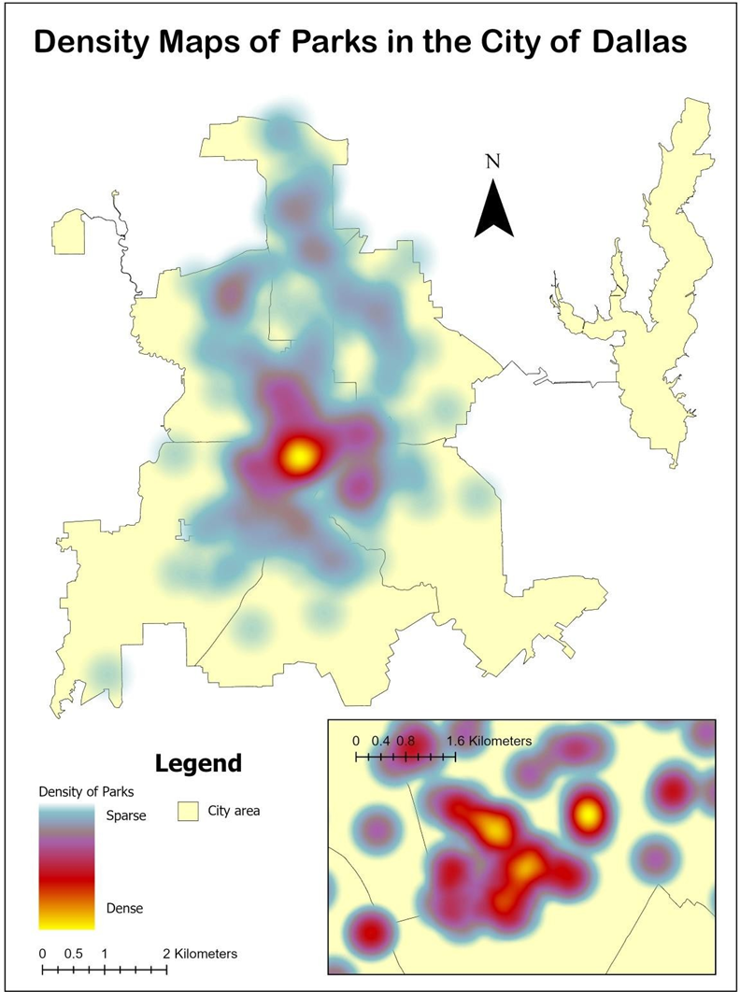
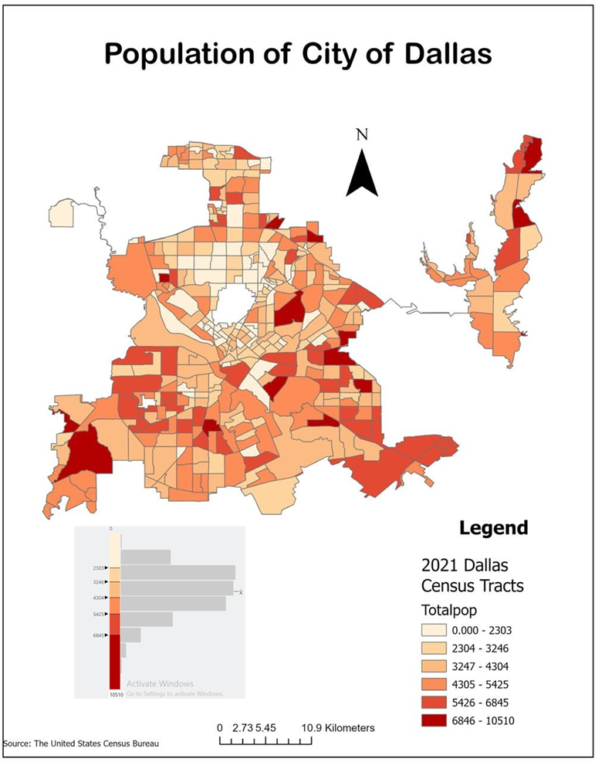
Distribution of Population and Parks
The density map of parks shows that most of the parks are concentrated in the center part of the city.
Population distribution is not concentrated in center area
Many special use parks are situated in Dallas which serve not only the people of the city but also people from outside of the city

Slide 18
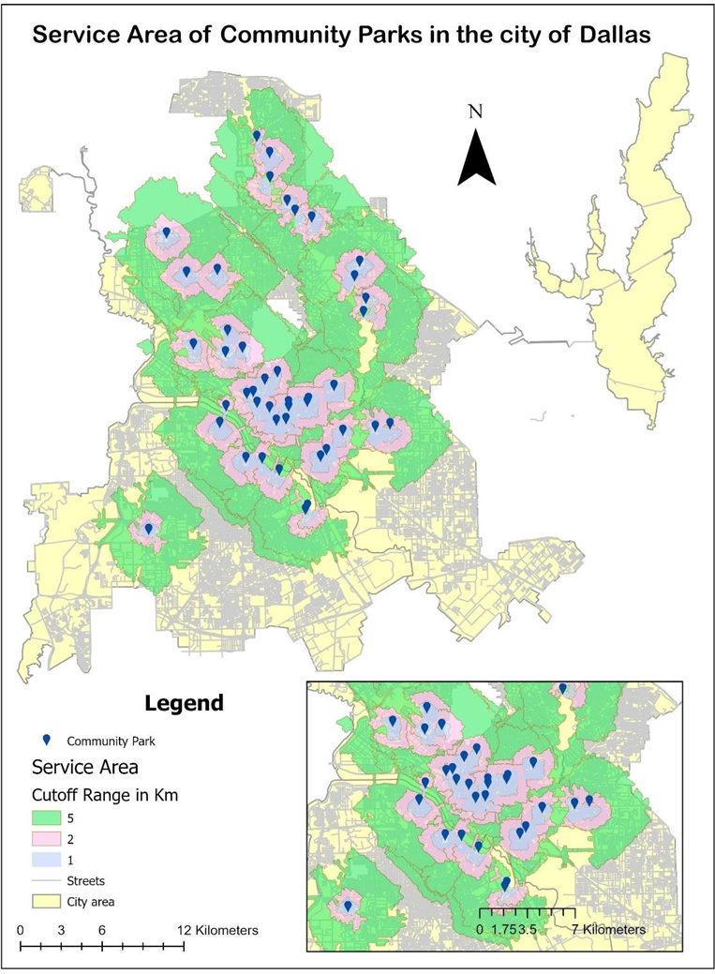
Accessibility of Community parks
The driving distance of 1,2 and 5 km has been identified.
the community parks throughout the city are accessible by most of the city population.
The southern part of the city is deprived of community parks
Some portions do not have any coverage of service of any community park.

Slide 19
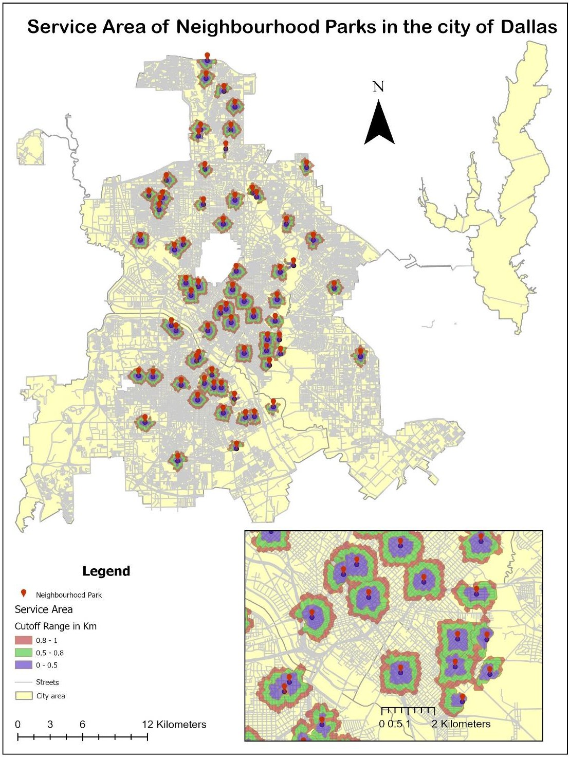
Accessibility of Neighborhood parks
Neighborhood parks should be situated within walking distance.
A network analysis of 0.5,0.8 and
1 km walking distance service area has been undertaken
The insufficiency of neighborhood parks all around the city.
Most of the areas of the city do not have coverage of neighborhood parks
Indicates less accessibility of people to the parks.

Slide 20
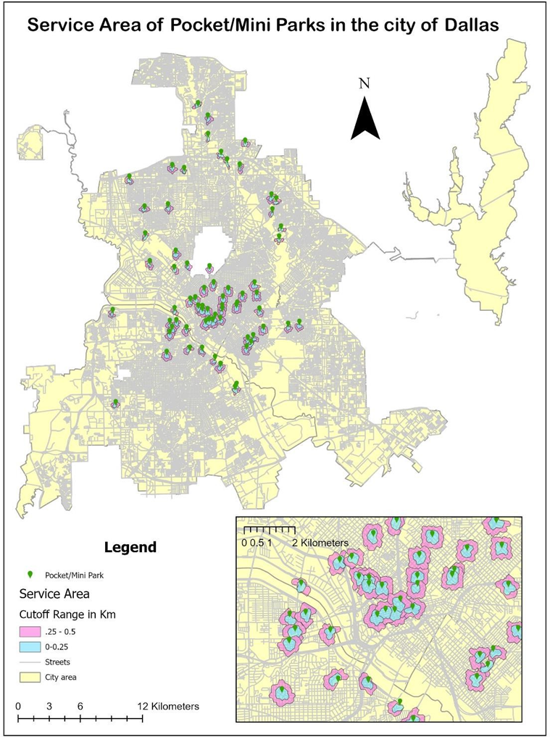
Accessibility of mini/pocket parks
Mini parks can be more than one in any neighborhood is more like a playground or tiny green space for the people
Should be accessible by people within walking distance.
The service area of 0.25 and 0. 5 km walking distance has been identified.
High insufficiency of mini parks all over the city.
Mini parks are concentrated in the center of the city whereas it should be distributed throughout the city evenly.

Slide 21
Recommendations and Planning Implication
Strategic Expansion of Neighborhood Parks
Identify and prioritize underprivileged areas lacking green spaces.
Ensure equitable distribution across socio-economic zones for better access.
Mini Parks for Micro-Communities
Partner with local businesses, schools, and residents to establish flexible spaces.
Provide seating, small play areas, and greenery tailored to micro-community needs.
Multi-Functional Design
Include walking trails, exercise zones, playgrounds, and cultural installations.
Cater to the varied interests of different community demographics.

Slide 22

Recommendations and Planning Implication
Green Corridors and Connectivity
Develop green corridors connecting centralized parks to neighborhoods.
Promote sustainable transportation options and pedestrian/cyclist-friendly pathways.
Community Engagement and Participation
Involve residents in neighborhood park planning and decision-making.
Conduct surveys and establish volunteer programs for maintenance and improvements
Foster ownership, community pride, and long-term stewardship of local parks.
Policy and Investment Focus
Policies should support targeted investments in park development in underserved areas.
Strategic budgeting and funding for implementing recommendations effectively.

Slide 23

Thank You !

